Slide 1
CIVIL ENGINEERING LEADERSHIP CE 4200 Professional Engineering Practice Issues
Spring 2022 Semester
William D. Lawson, P.E., Ph.D.

Slide 2
CONTEXT
CIVIL ENGINEERING LEADERSHIP Professional Engineering Practice Issues
2

Slide 3
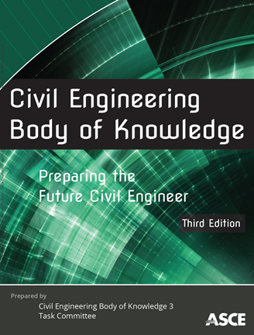
BOK3 Outcomes
Mathematics
Natural Sciences
Social Sciences
Humanities
Materials Science
Engineering Mechanics
Experimental Methods and Data Analysis
Critical Thinking and Problem Solving
Project Management
Engineering Economics
Risk and Uncertainty
Breadth in Civil Engr Areas
Design
Technical Depth
Sustainability
Communication
Teamwork and Leadership
Lifelong Learning
Professional Attitudes
Professional Responsibilities
Ethical Responsibilities

Slide 4
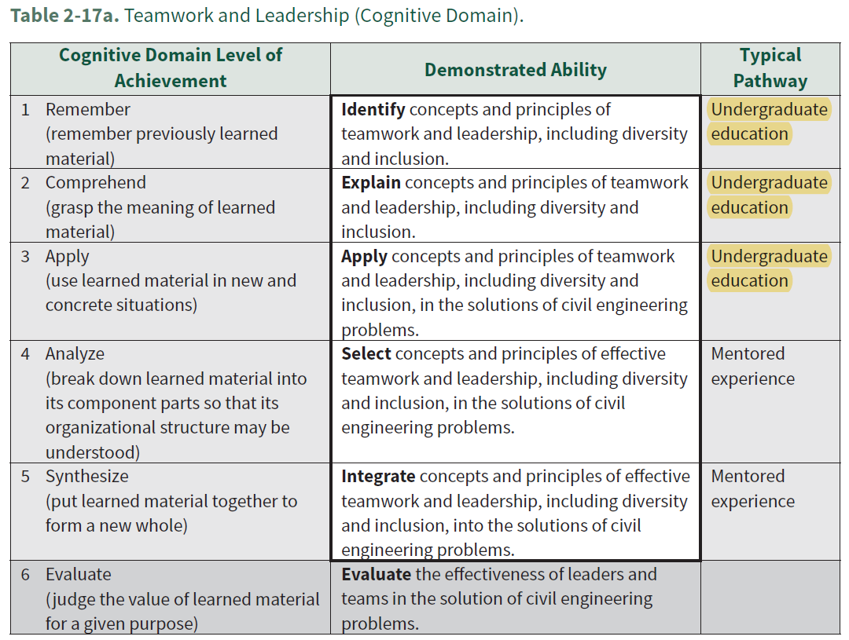

Slide 5
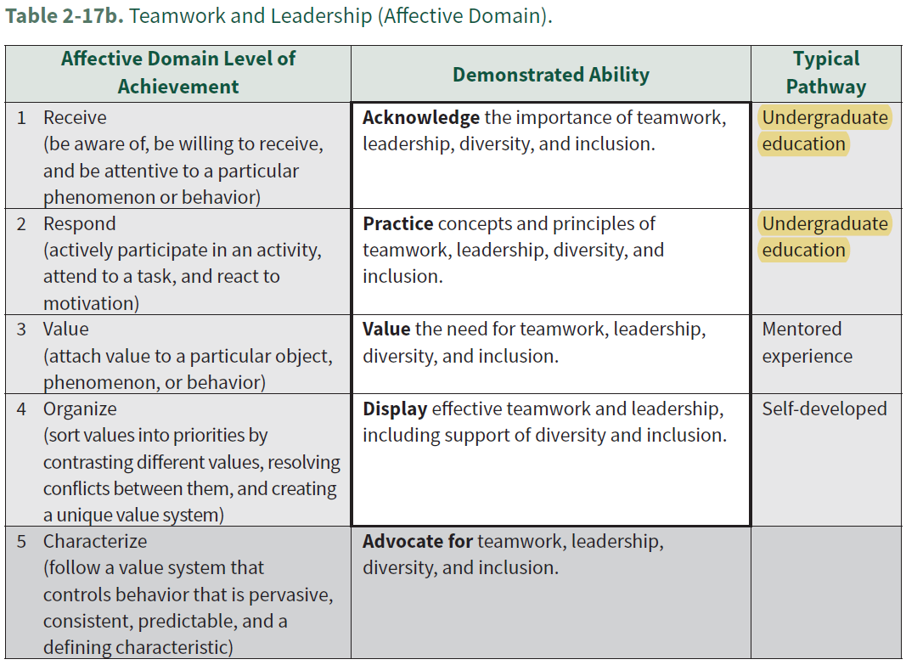

Slide 6


Slide 7
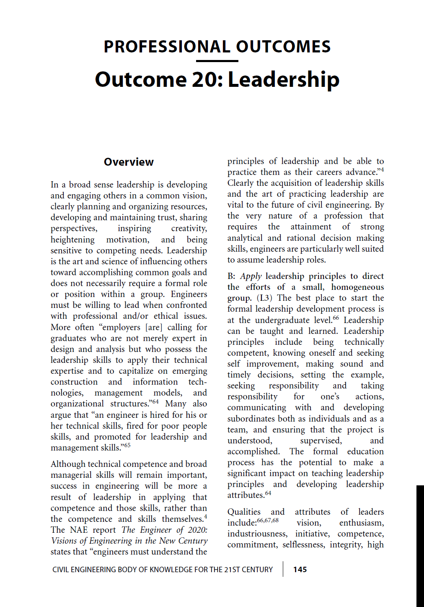

Slide 8
Guidance for Students Civil Engineering Body of Knowledge for the 21st Century

Slide 9
Some Leadership quotes
CIVIL ENGINEERING LEADERSHIP Professional Engineering Practice Issues
9

Slide 10
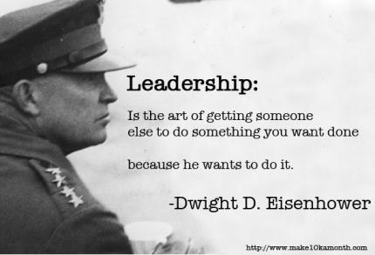

Slide 11
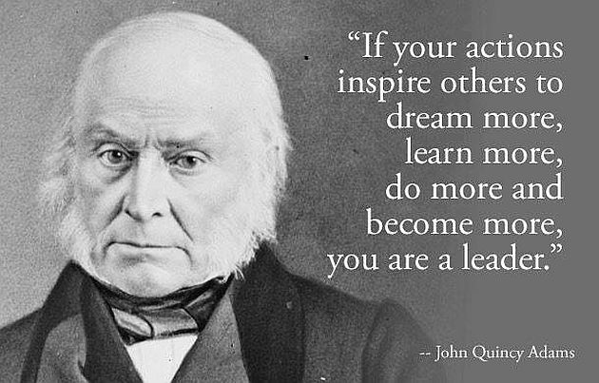

Slide 12
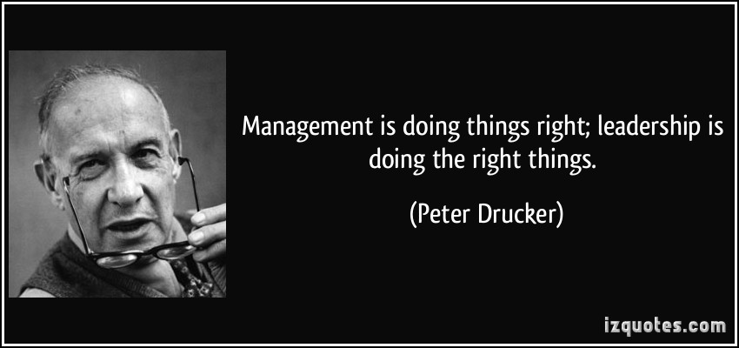

Slide 13

In the world of work, there are only two futures -- the one you proactively create for yourself and your organization or, in the vacuum of little or no action, the future created for you by others.
-Stu Walesh

Slide 14
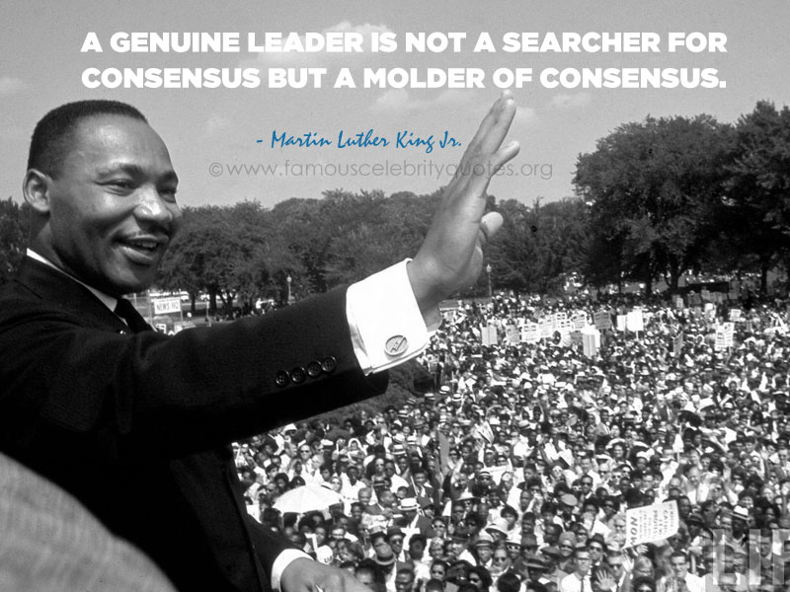

Slide 15
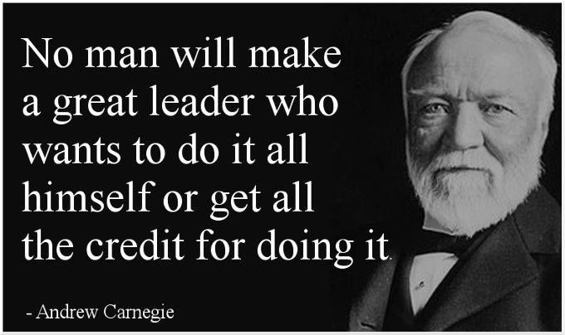

Slide 16
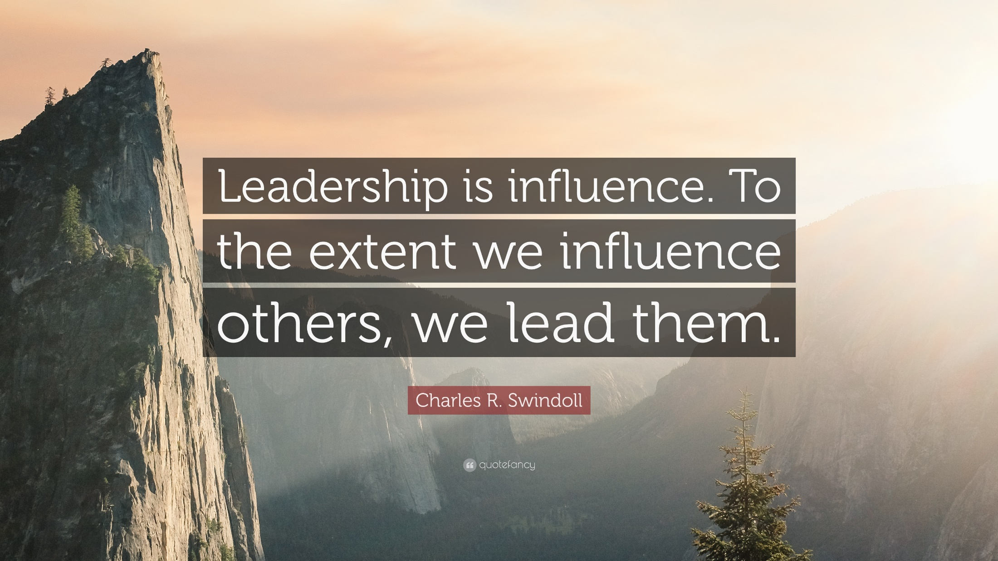

Slide 17
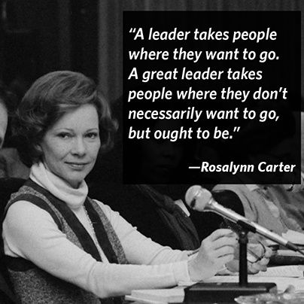

Slide 18
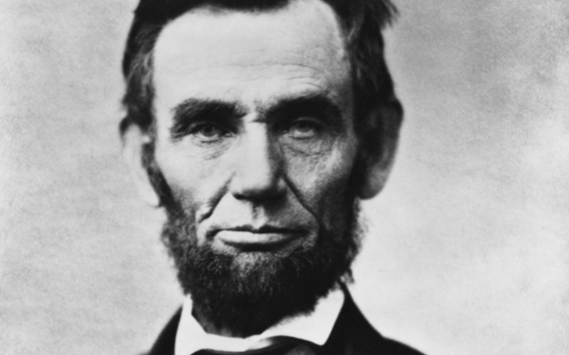
“You have to do your own growing no matter how tall your grandfather was.”
-Abraham Lincoln

Slide 19
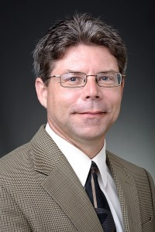
“An engineer is hired for his or her technical skills, fired for poor people skills, and promoted for leadership and management skills.”
-Jeffery S. Russell

Slide 20
leadership traits
CIVIL ENGINEERING LEADERSHIP Professional Engineering Practice Issues
20

Slide 21

GROUP EXERCISE
ON YOUR OWN: Identify three characteristics of a good leader
SHARE our lists.

Slide 22
U.S. Army's 23 Traits of Character
Bearing
Confidence
Courage
Integrity
Decisiveness
Justice
Endurance
Tact
Initiative
Coolness
Maturity
Improvement
Will
Assertiveness
Candor
Sense of humor
Competence
Commitment
Creativity
Self-discipline
Humility
Flexibility
Empathy/Compassion

Slide 23
leadership assignment
CIVIL ENGINEERING LEADERSHIP Professional Engineering Practice Issues
23

Slide 24
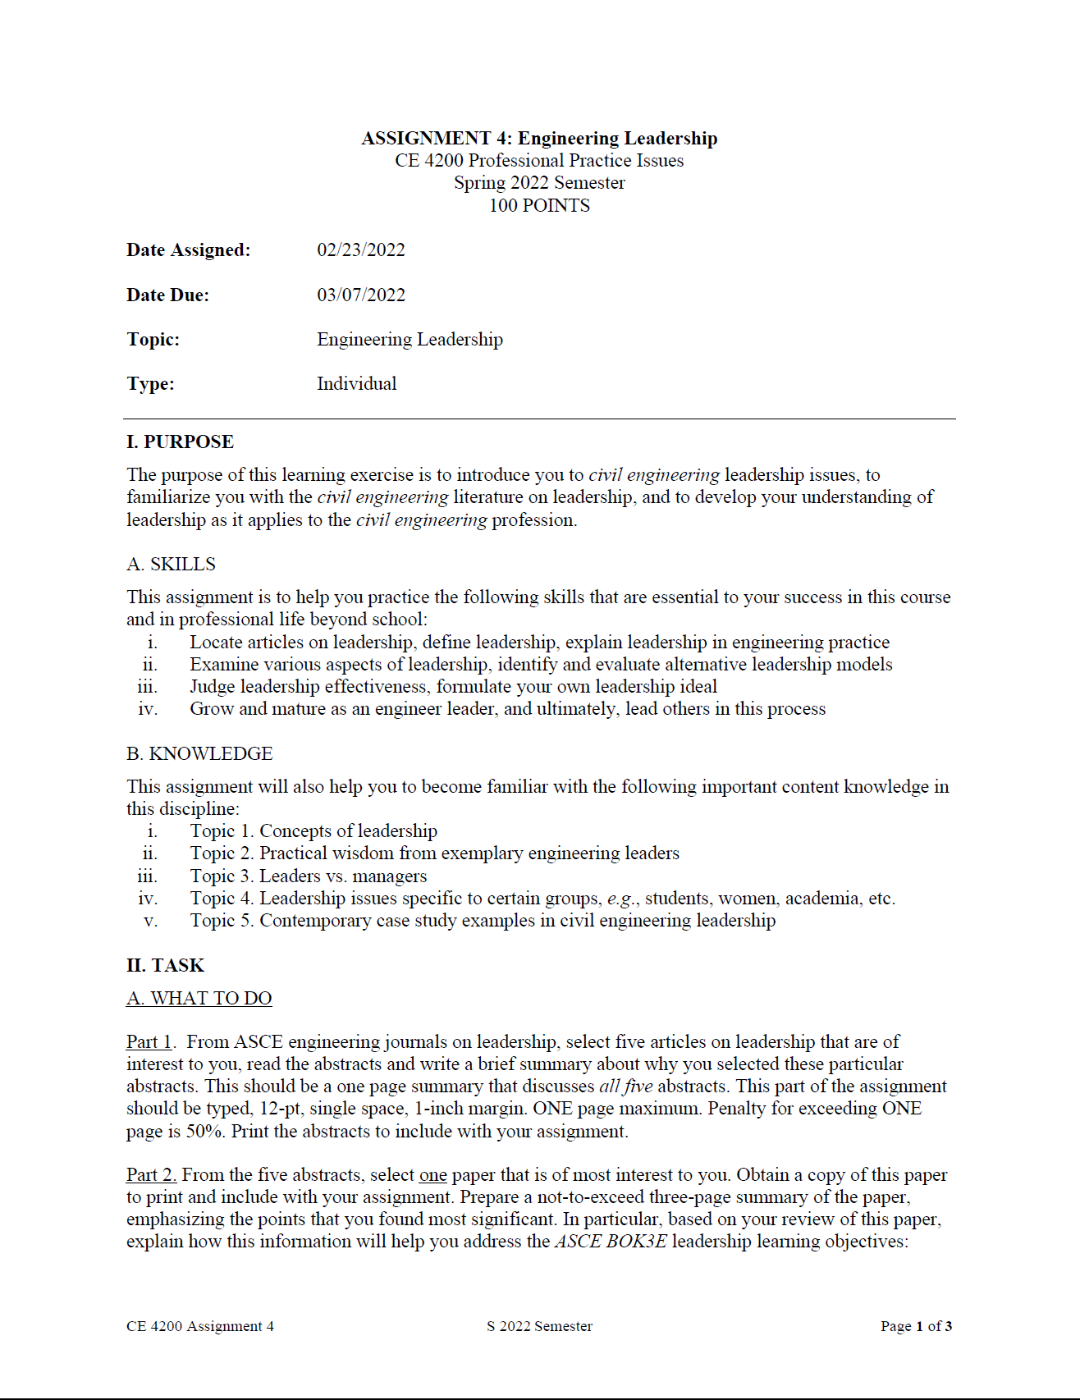

Slide 25
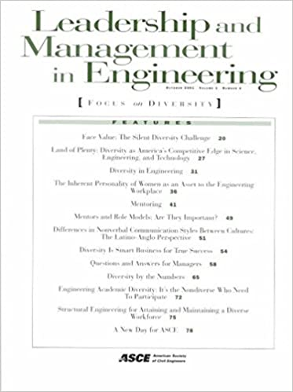

ASCE Journals

Slide 26


ASCE Journals

Slide 27
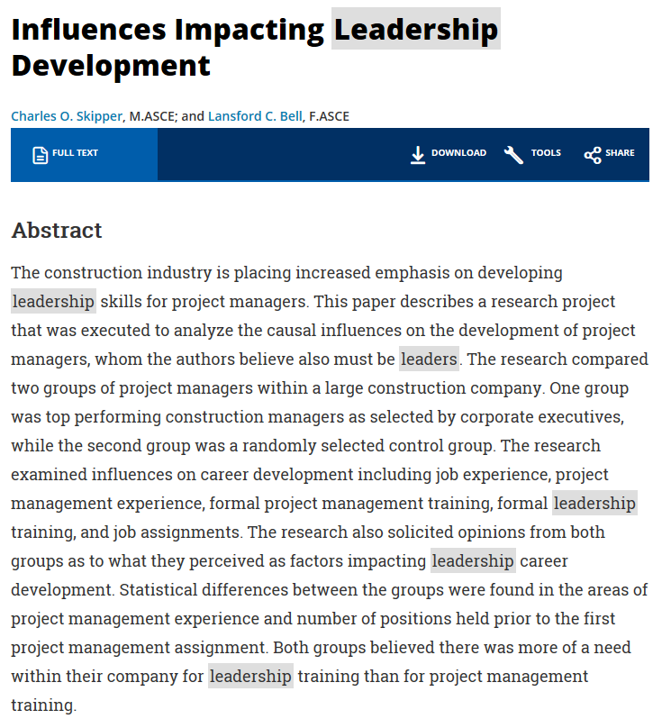

Slide 28
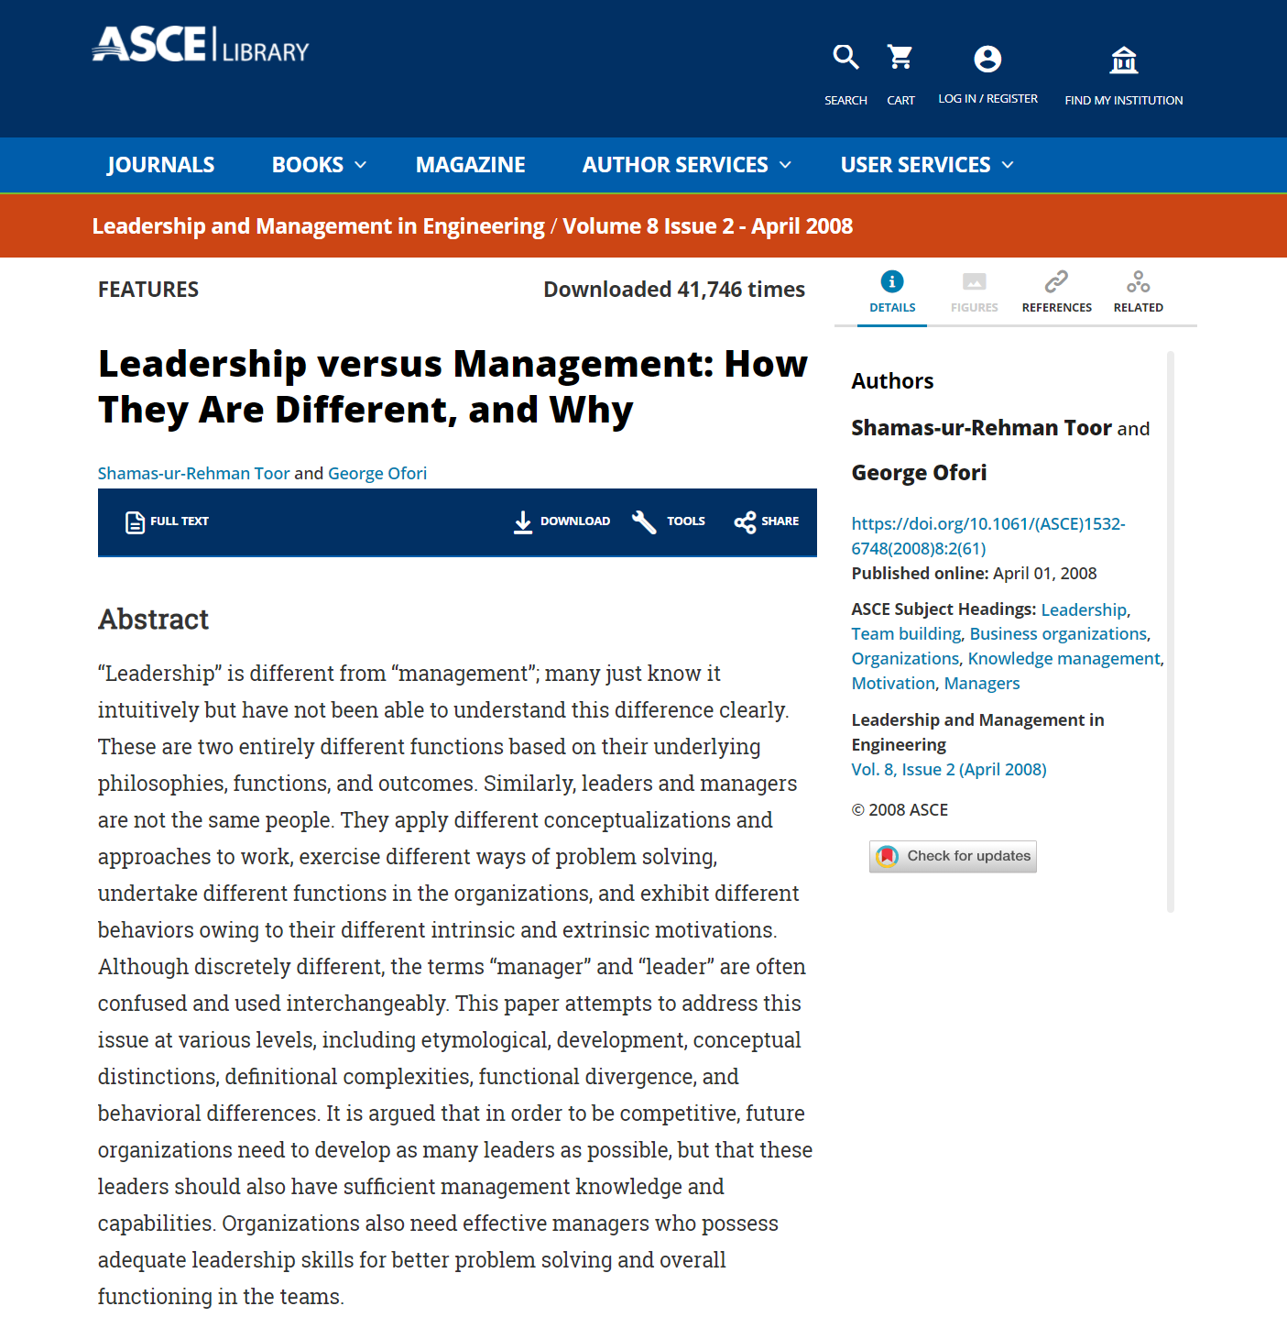

Slide 29
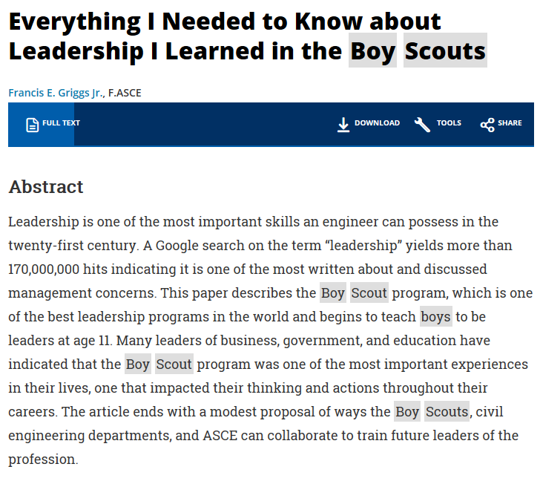

Slide 30
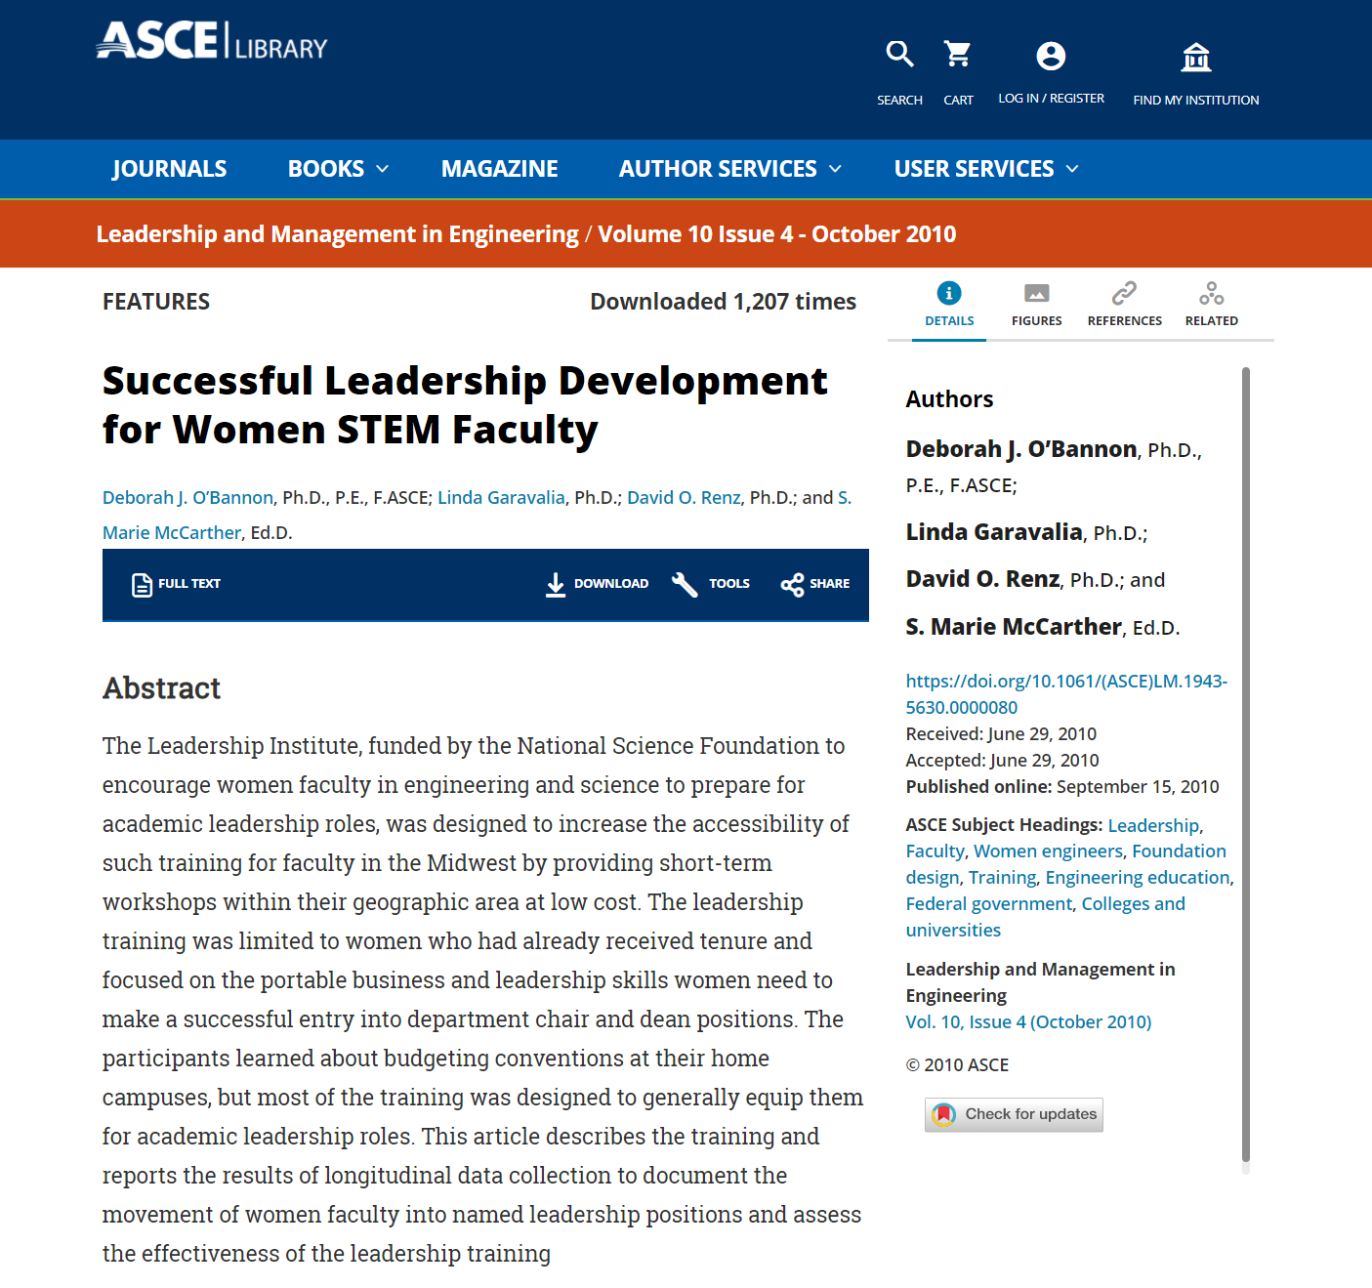

Slide 31
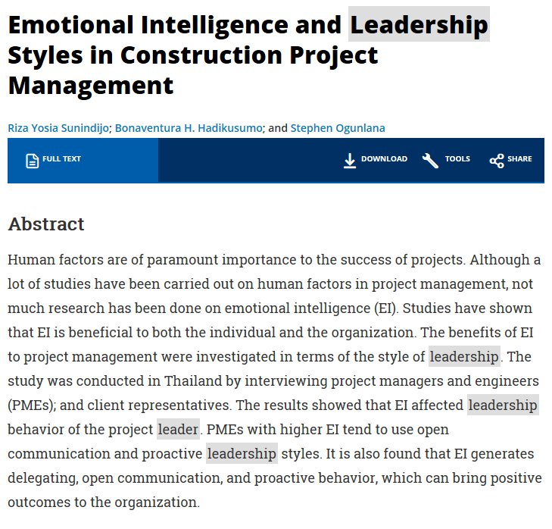

Slide 32
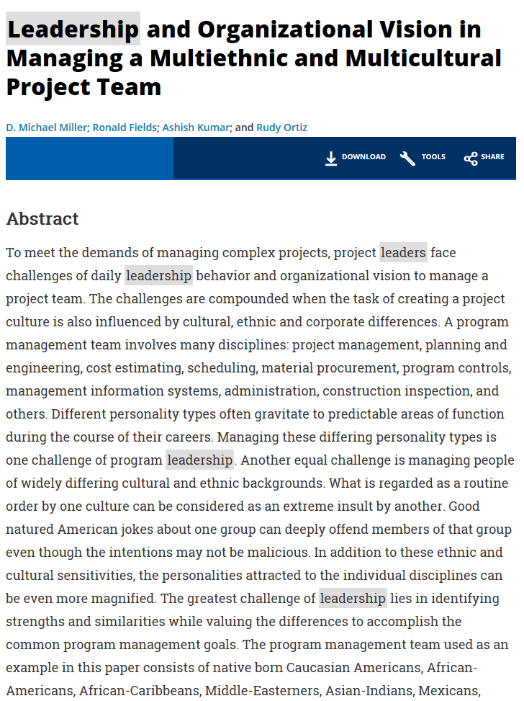

Slide 33
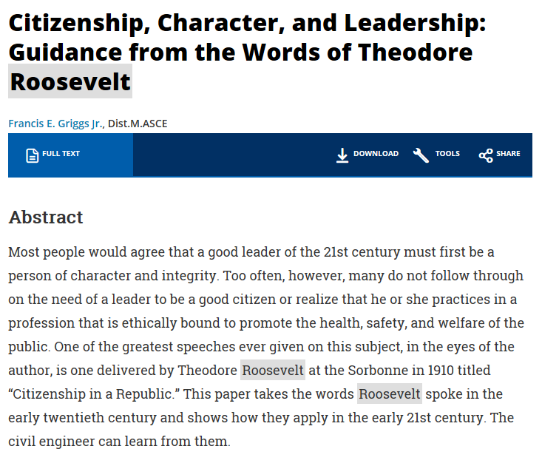

Slide 34
THANK YOU.

